Slide 1

ML4CV Group
Group Discussion
November 2, 2020

Slide 2
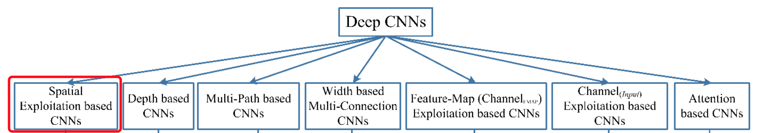
Spatial Exploitation based CNNs
2020.10.12

Slide 3
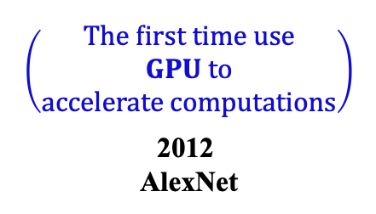
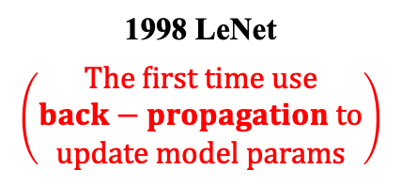
Spatial Exploitation:
$$\left(\begin{aligned}The first time use \\ GPU to \\ accelerate computations\end{aligned}\right)$$
2012
AlexNet
2015
VGGNet
1998 LeNet
$$\left(\begin{aligned}The first time use \\ back−propagation to \\ update model params\end{aligned}\right)$$
2013
ZfNet
2015
GoogLeNet

Slide 4
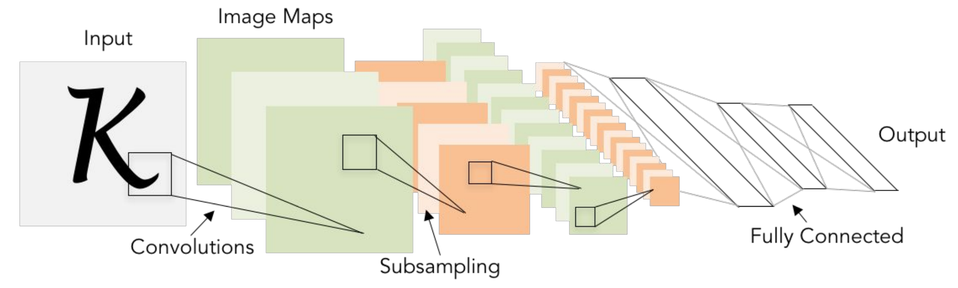
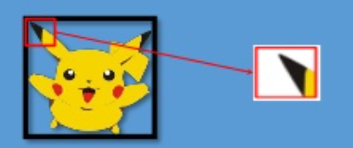
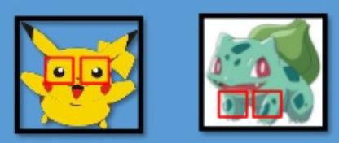
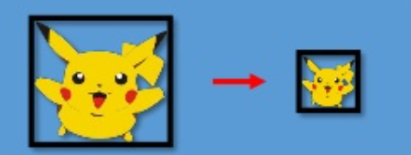
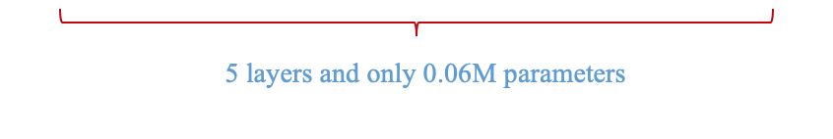
LeNet: First popular CNN architecture
6@28x28
Grayscale image
C1
16@10x10
Sigmoid or tanh nonlinearity
C2
S1
S2
120
C3
84
3 key ideas:
Local Receptive Fields
Shared Weights
Sub-sampling
F4
OUT
5x5, s=1
average pooling
2x2, s=2
LeCun et al. Gradient Based Learning Applied to Document Recognition. 1998

Slide 5
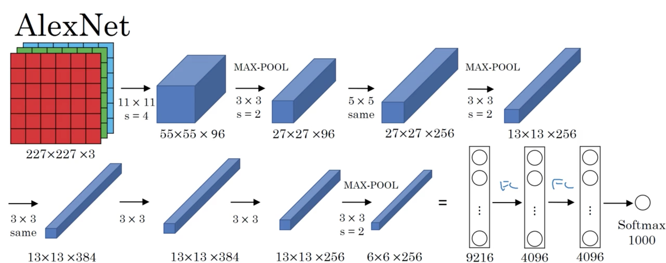
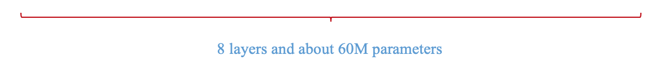
AlexNet: First deep CNN architecture
96@11x11
MP1
256@5x5
MP2
key contributions:
GPU and training in parallel
ReLu Activation
Dropout regularization
Heavy data Augmentation
C1
C2
384@3x3
256@3x3
MP3
384@3x3
C4
C5
FC8
C3
FC6
FC7
Krizhevsky et al. ImageNet Classification with Deep Convolutional Neural Networks. 2012

Slide 6
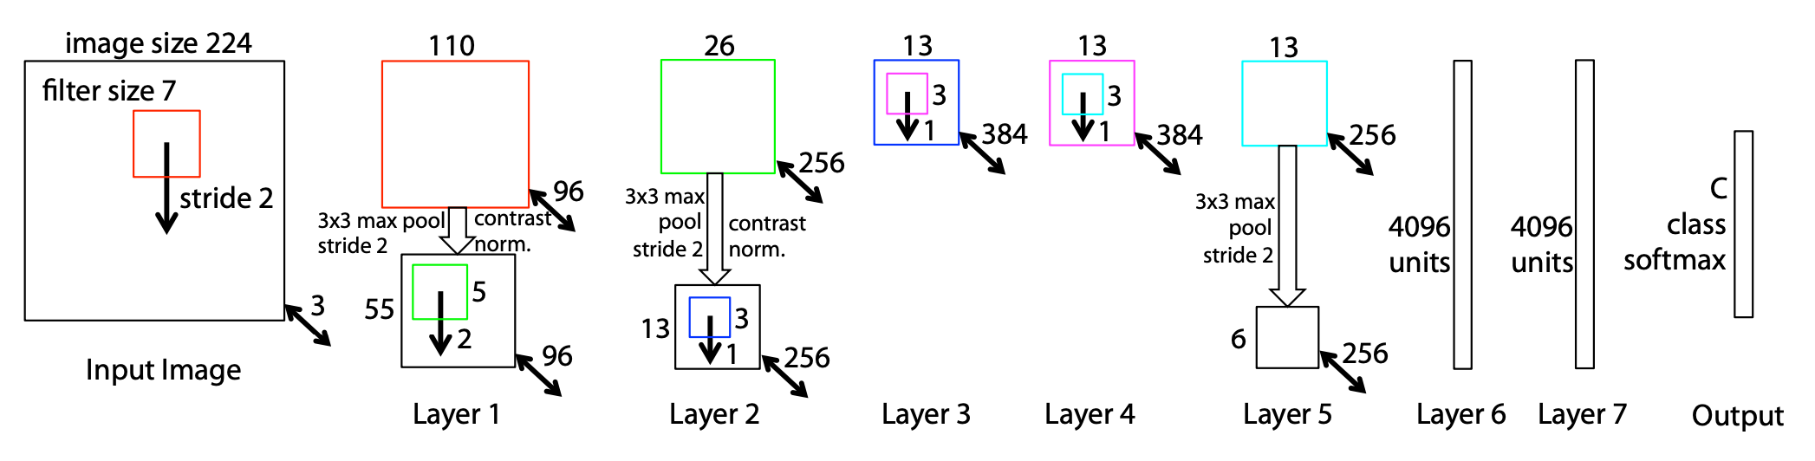
ZfNet: Refinement of AlexNet
AlexNet but:
CONV1:
change from (11x11 stride 4) to (7x7 stride 2)
CONV3, 4, 5:
instead of 384, 384, 256 filters use 512, 1024, 512
key contributions:
Introduced the idea of parameter tuning
by visualizing the output of intermediate layers
Zeiler and Fergus. Visualizing and Understanding Convolutional Networks. 2013

Slide 7
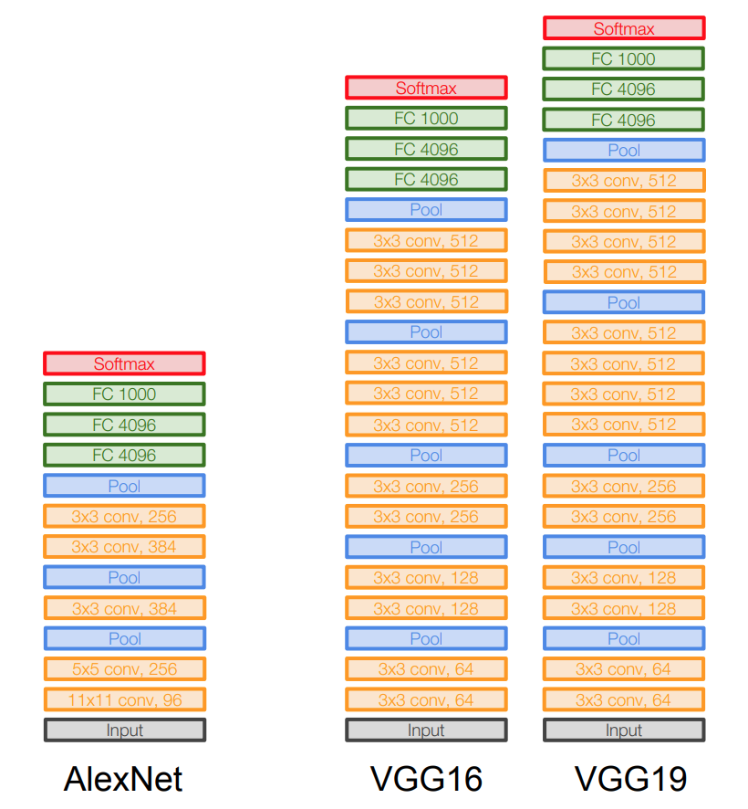
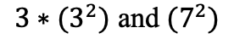
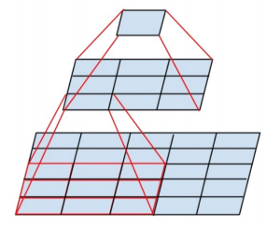
VGGNet: Small filters, deeper networks
Why small filters:
Stack of three 3x3 conv(stride 1) layers has same effective receptive field as one 7x7 conv layer
But deeper, more non-linearities, and fewer parameters:
7x7, s=1
key points:
Depth is important
Simplify the network to go deep
138M parameters(mostly due to the FC layers)
5x5, s=1
Simonyan and Zisserman. Very Deep Convolutional Networks for Large-Scale Image Recognition. 2015

Slide 8
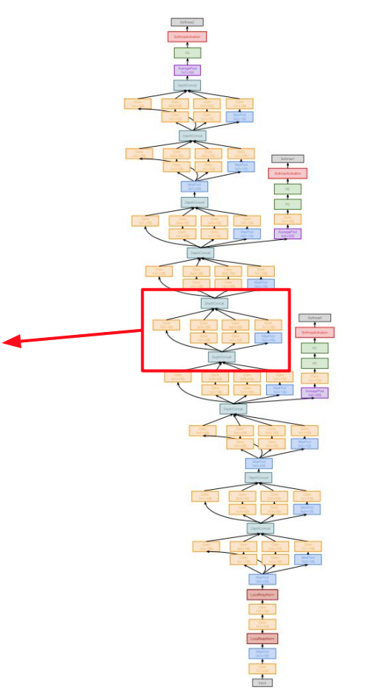
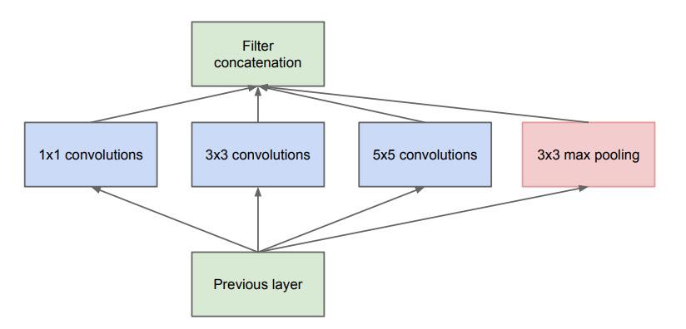
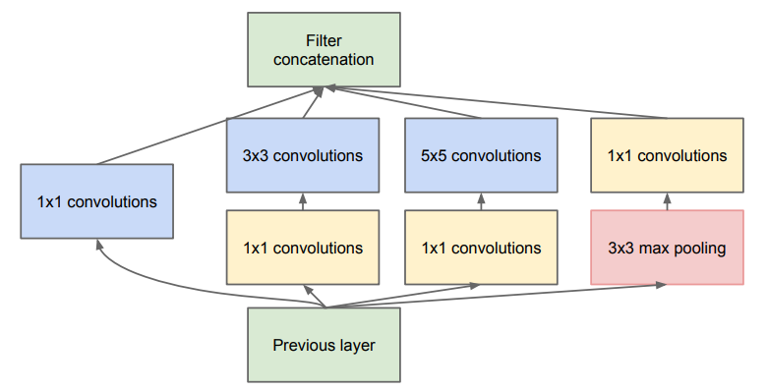
GoogLeNet: The Inception Module
22 layers
Naïve Inception Module
Inception Module
Parallel paths with different receptive field sizes and operations
Capture sparse patterns of correlations in the stack of feature maps
Szegedy et al. Going deeper with convolutions. 2015

Slide 9
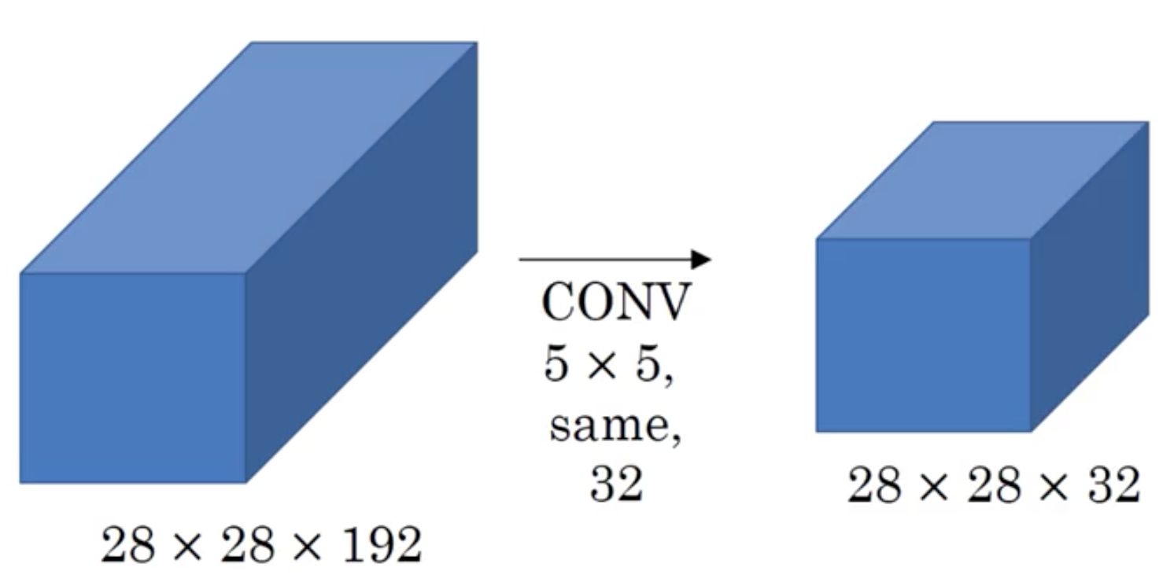
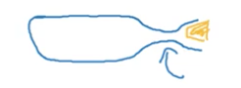
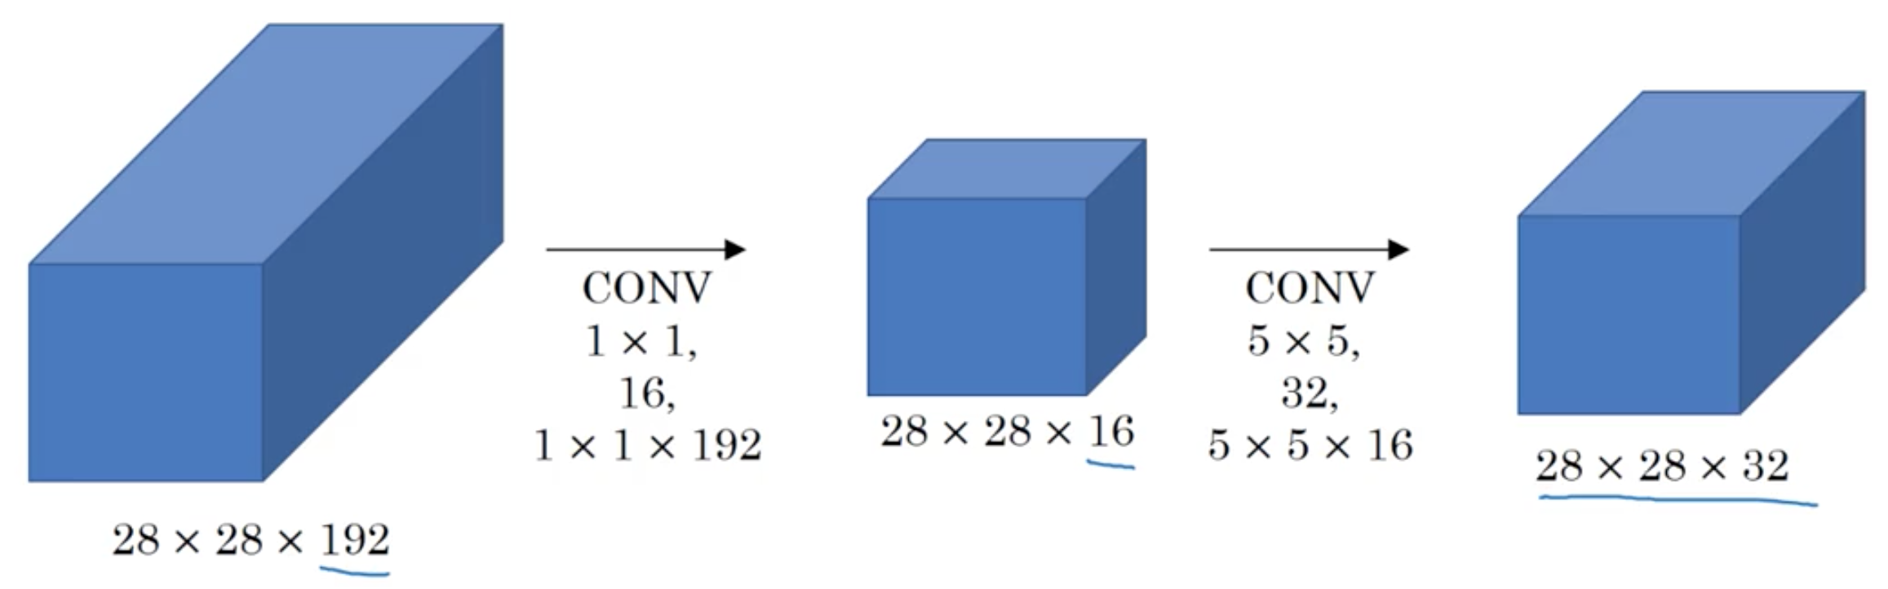
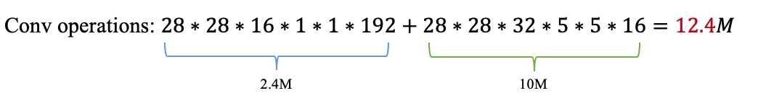
GoogLeNet: With computational efficiency
1x1 conv “bottleneck” layers:
Preserves spatial dimensions, reduce feature depth
key ideas:
22 layers
Efficient “inception” module
Use “bottleneck” layer to reduce feature depth
No FC layers
Only 4M parameters
Szegedy et al. Going deeper with convolutions. 2015

Slide 10
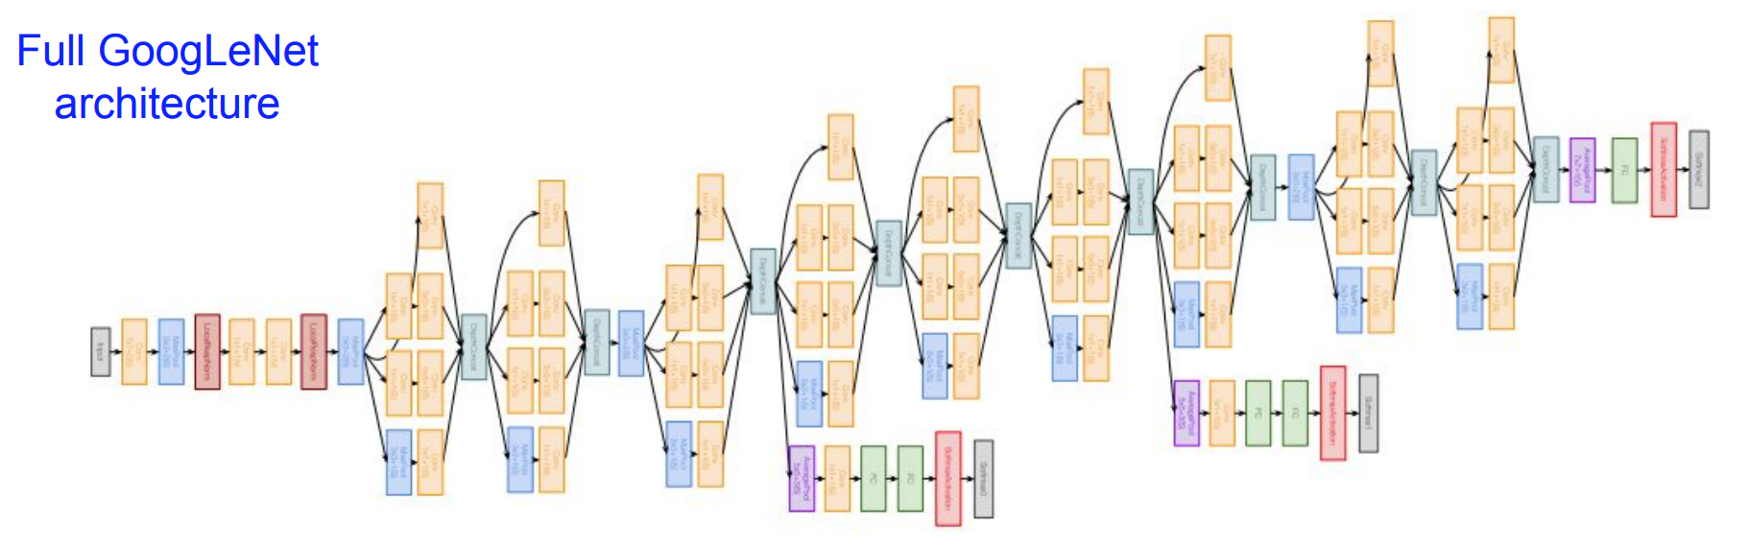
GoogLeNet: Architecture
Output
Stem network:
Conv-Pool-2x Conv-Pool
Auxiliary classification outputs:
AvgPool-1x1Conv-FC-FC-Softmax
Stacked Inception Module
Szegedy et al. Going deeper with convolutions. 2015

Slide 11
Depth Based CNNs
Zhiqiang Wang
October 12, 20220
Southern University of Science and Technology

Slide 12
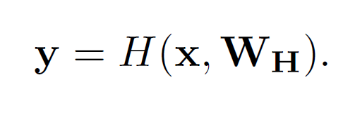
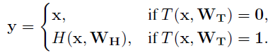
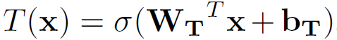
Highway Networks
如何训练深度网络
Question:
Theoretical and empirical evidence show that depth of neural networks is a crucial ingredient for their success. However, network training becomes more difficult with increasing depth.
layers of a plain feedforward neural network
For simplicity, we can set C = 1 - T
H is usually an afffine transform followed by a non-linear activation function.
A block with two non-linear transform.
architecture of highway networks
T denotes transform gate and C denotes carry gate.
b_{T} can be initialized with a negative value such that the network is initially biased towards carry behavior.

Slide 13
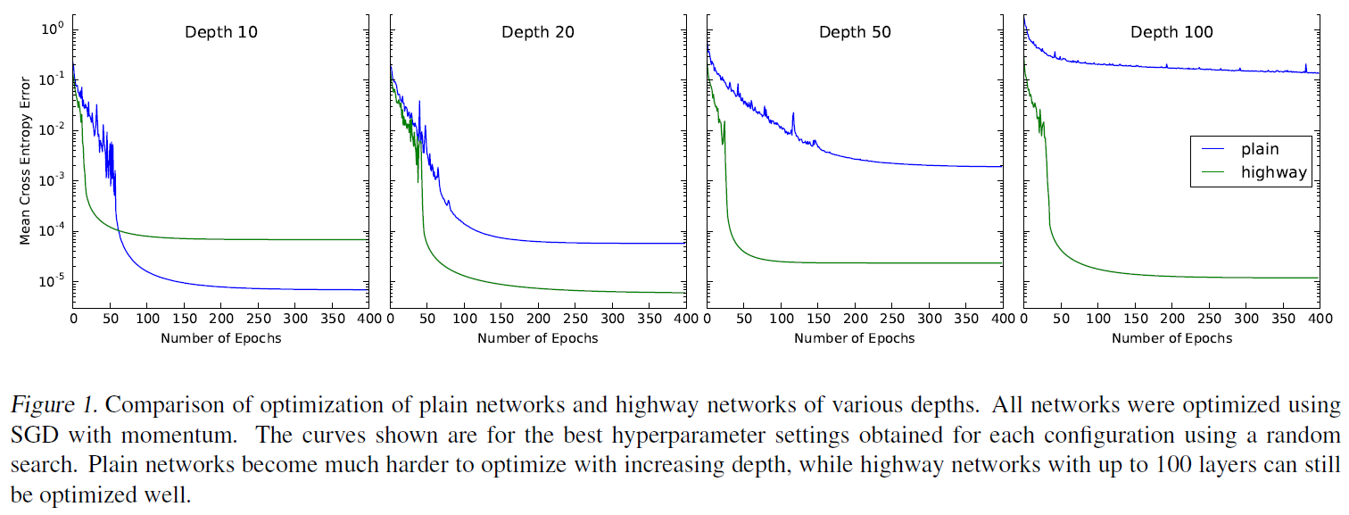
Highway Networks

Slide 14
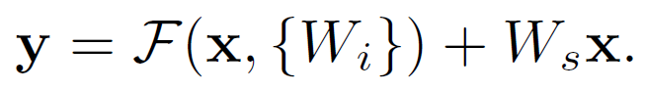
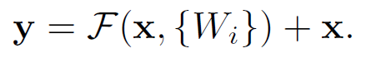
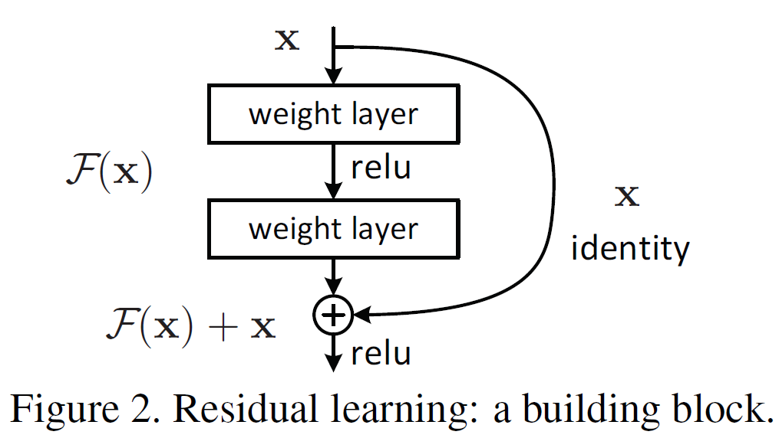
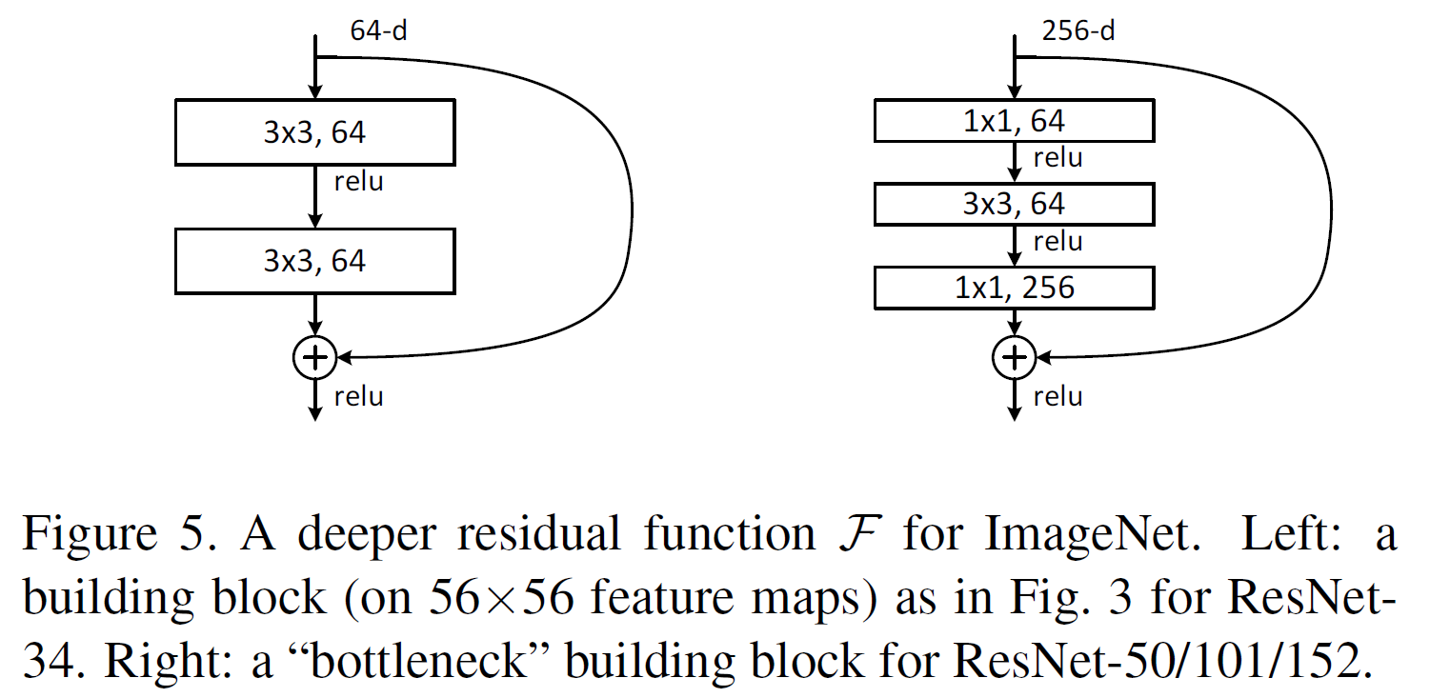
ResNet
Question:
Deeper neural networks are more difficult to train.
Instead of hoping each few stacked layers directly fit a desired underlying mapping, we explicity let these layers fit a residual mapping.
Matching dimensions. (Size & Depth)
The form of the residual function F is flexible.
(2 or 3 layers, while more layers are possible)

Slide 15
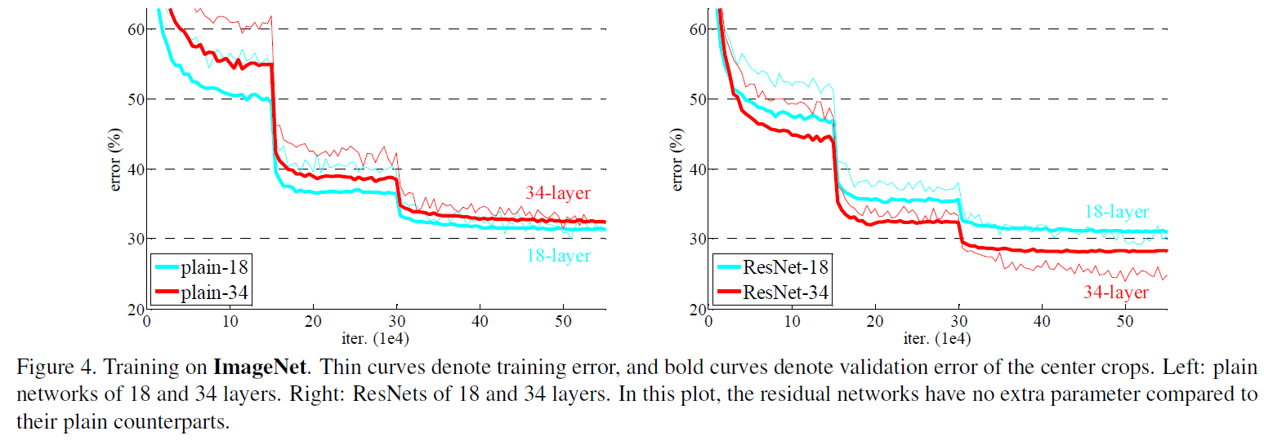
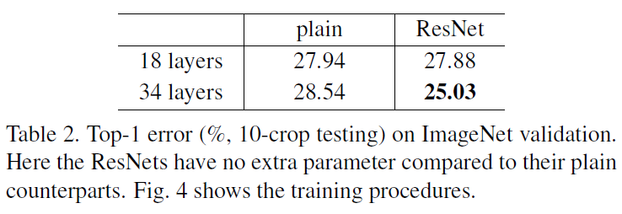
ResNet
深层网络的退化问题在ResNet中得到了解决，并且预测的准确率随着网络的加深而提高了。
相比于plain networks，同等的ResNet在提升准确率上表现得更好。
ResNet在训练的前期收敛更快。

Slide 16

Inception

Slide 17
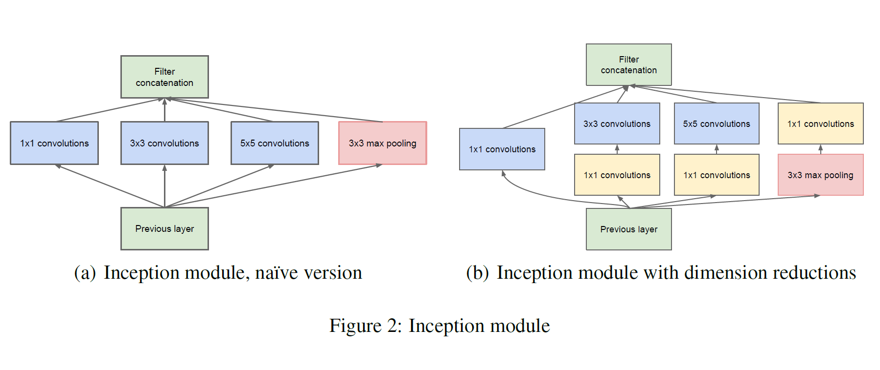
Inception v1
The main hallmark of this architecture is the improved utilization of the computing resources inside the network. This was achieved by a carefully crafted design that allows for increasing the depth and width of the network while keeping the computational budget constant.

Slide 18
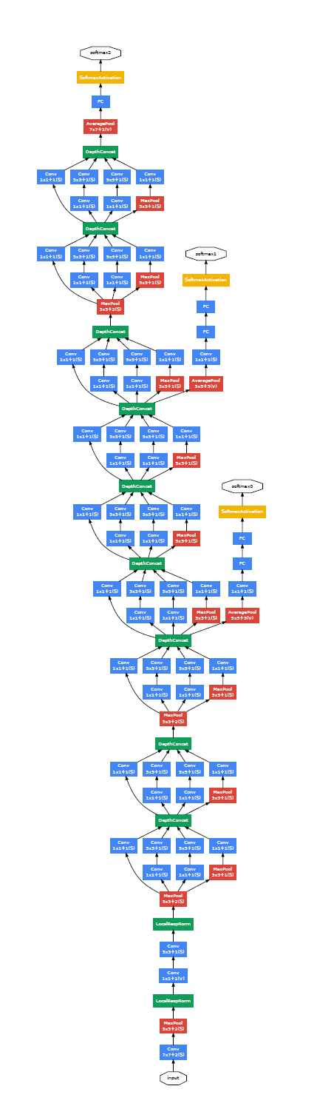
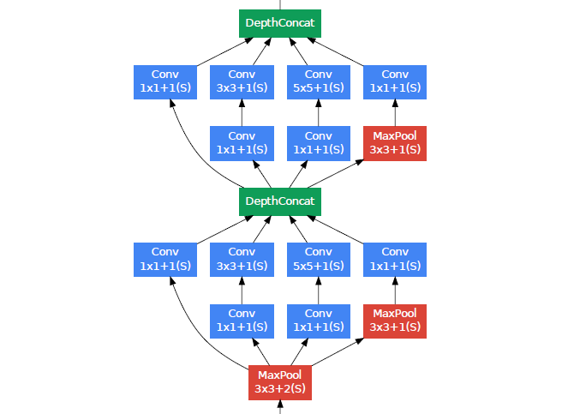
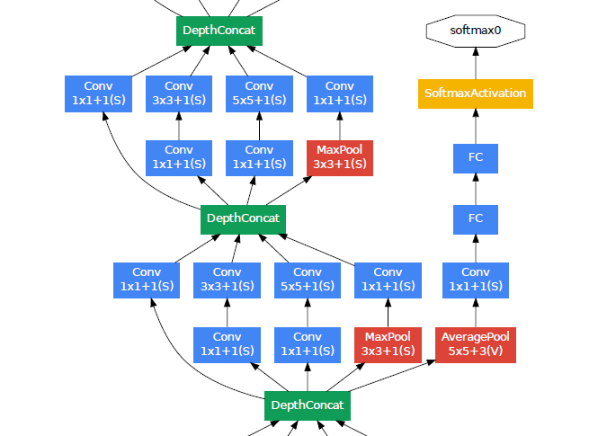
GoogLeNet
Inception v1
Auxiliary classifier

Slide 19
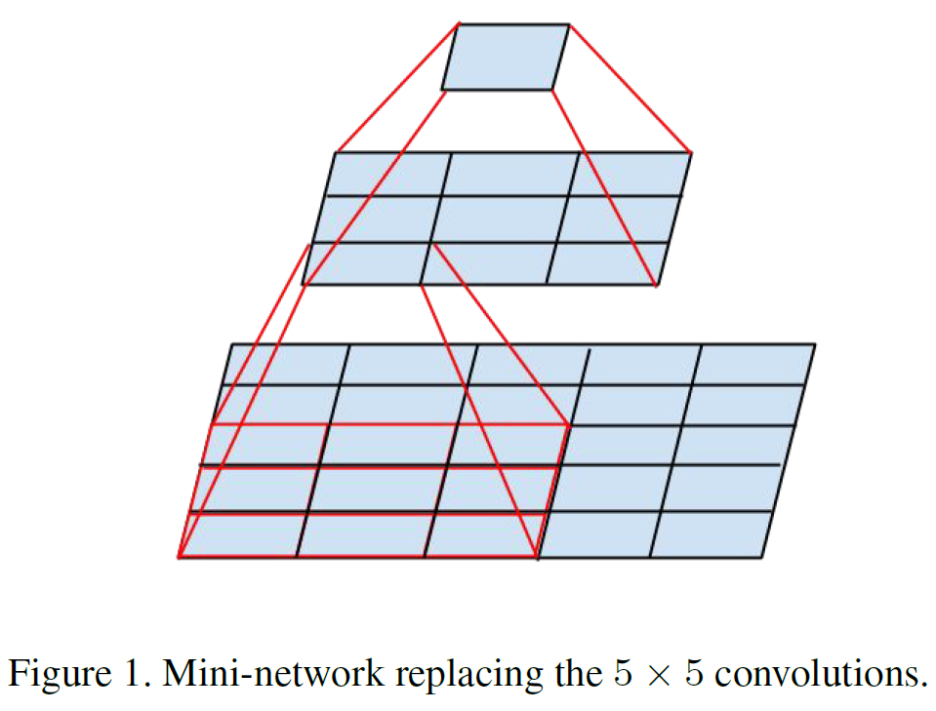
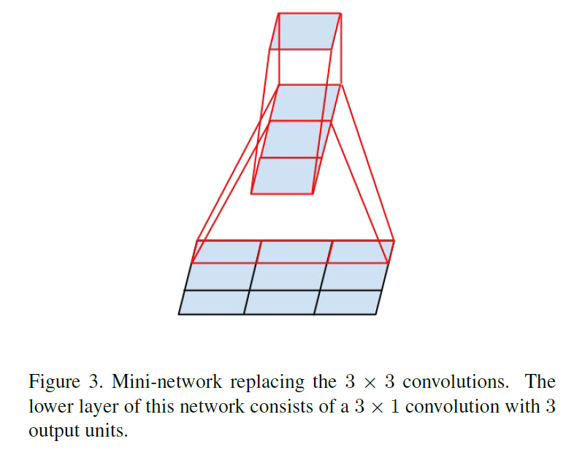
Inception v2 & Inception v3

Slide 20
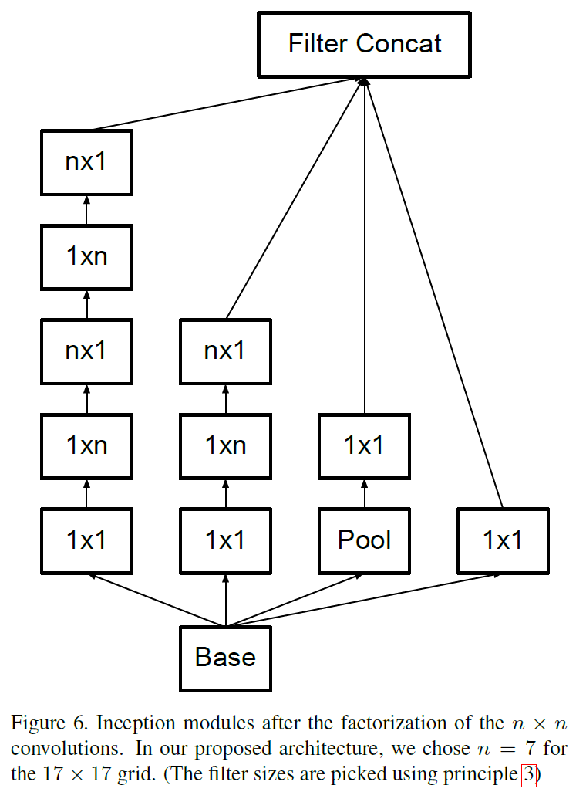
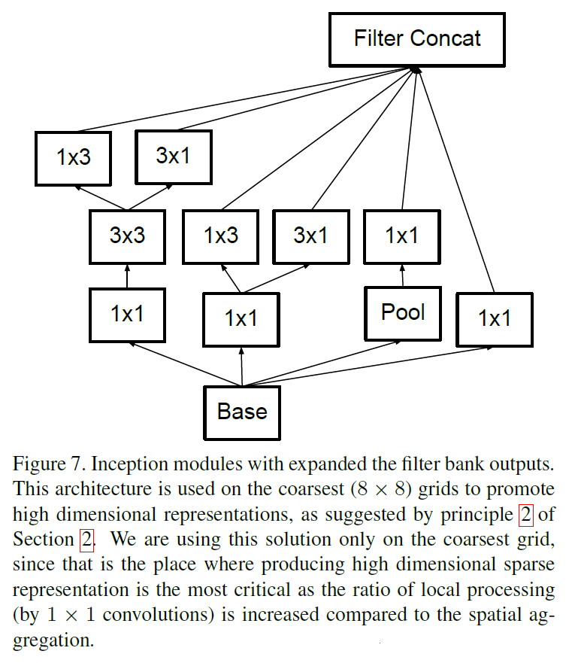
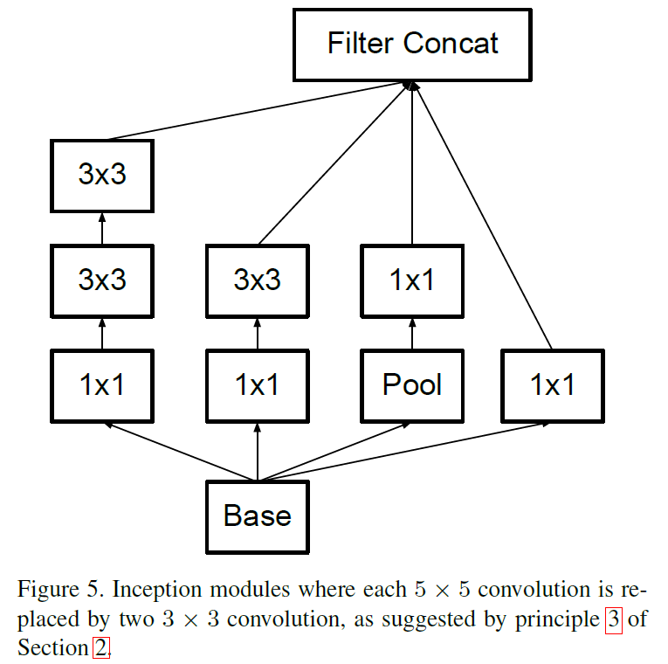
Inception v2 & Inception v3
The idea of Inception-v3 was to reduce the computational cost of deep networks without affecting the generalization by replacing large size filters with small and asymmetric filters and using 1*1 convolution as a bottleneck before the large filters.

Slide 21
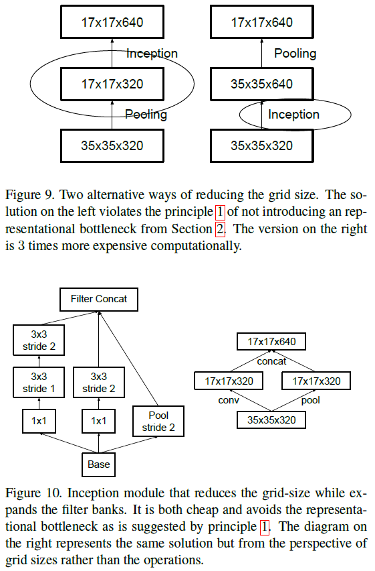
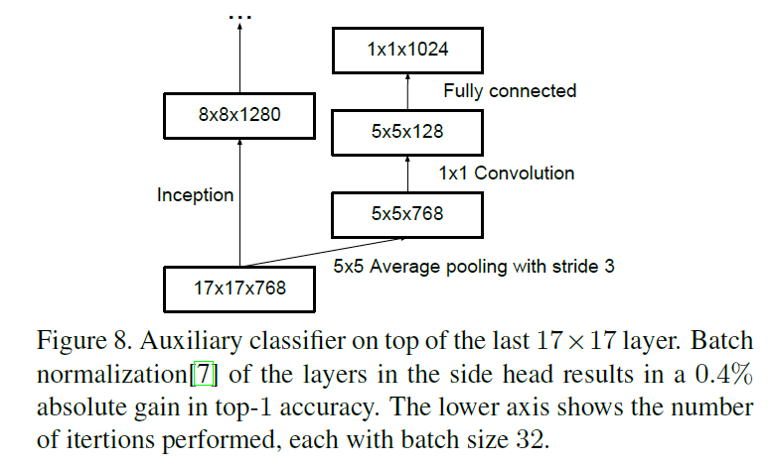
Inception v2 & Inception v3
Grid Size Reduction
左图：
先池化，再1*1卷积升维
信息丢失太大
右图：
先升维，再池化
计算开销非常大
池化和卷积并行
在降低计算量的同时，避免表征瓶颈
在训练的早期，辅助分类器的存在并没促进收敛；
而训练快结束时，辅助分类器的存在会提升网络的准确率。
结论：辅助分类器起到的是正则化的作用。

Slide 22
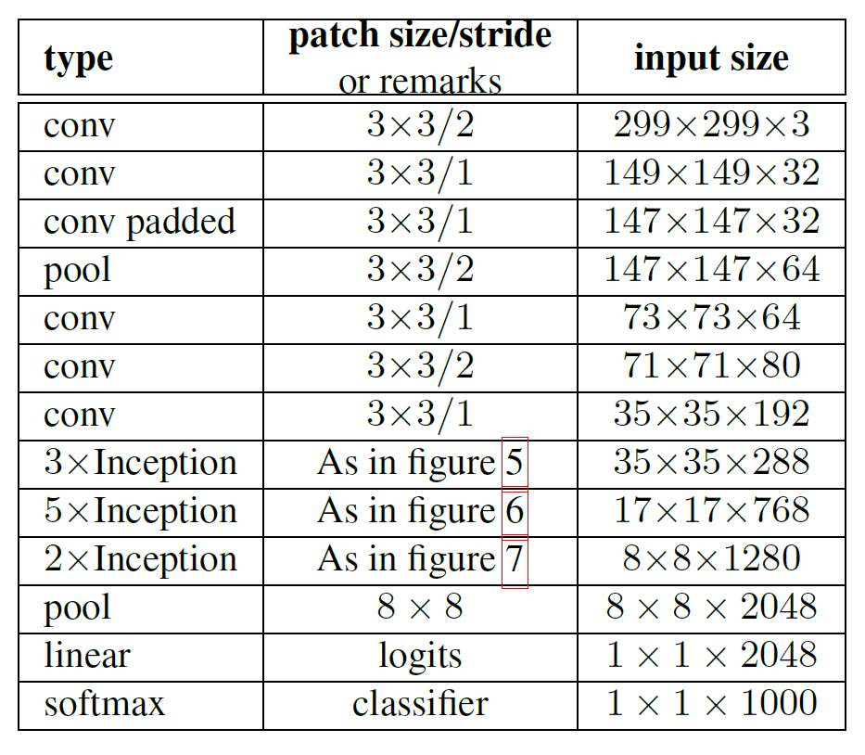
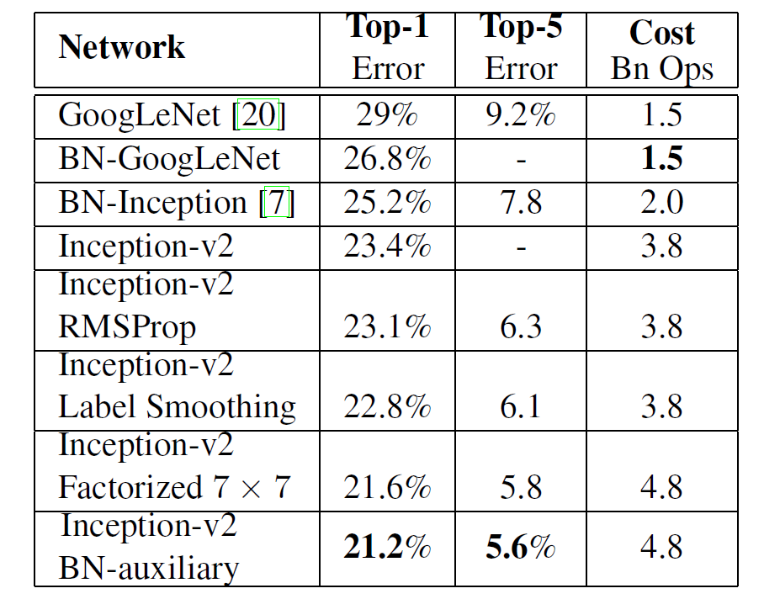
Inception v2 & Inception v3
Architecture of Inception v2
Inception v3

Slide 23
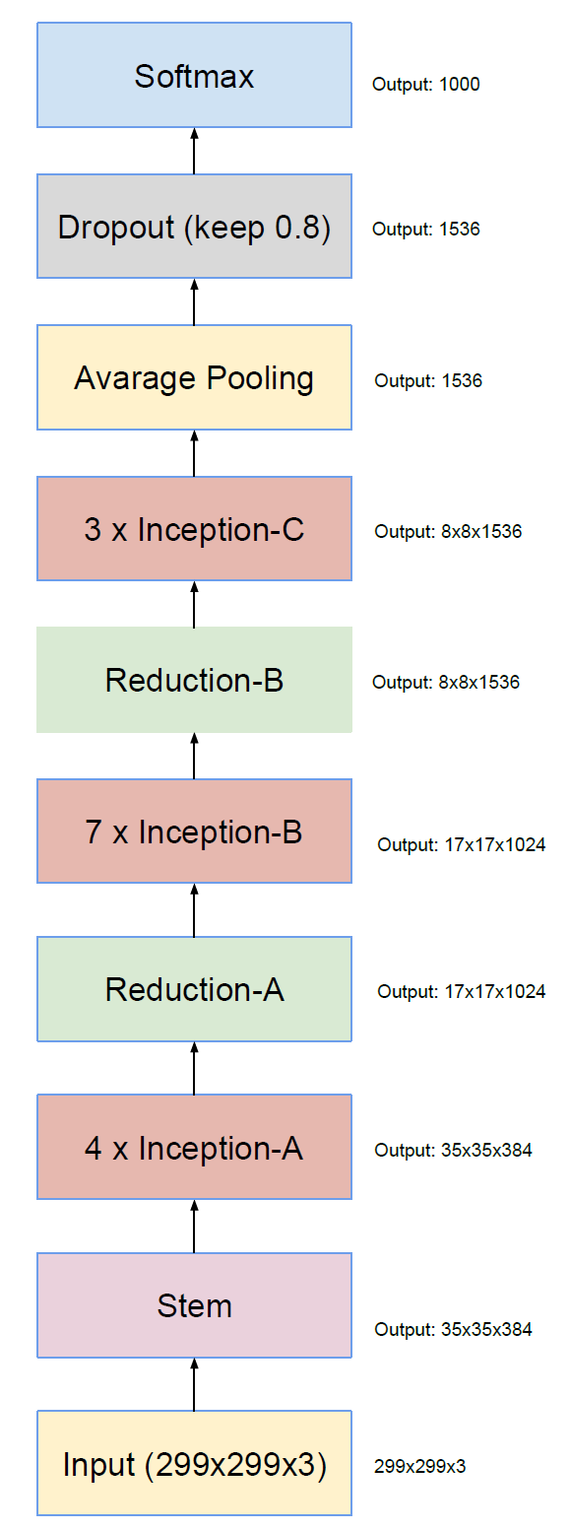
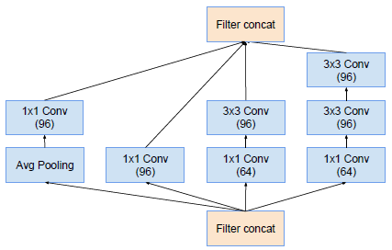
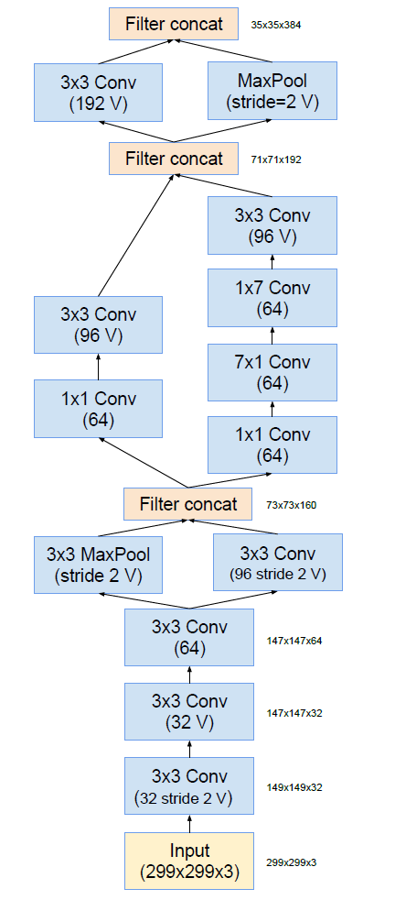
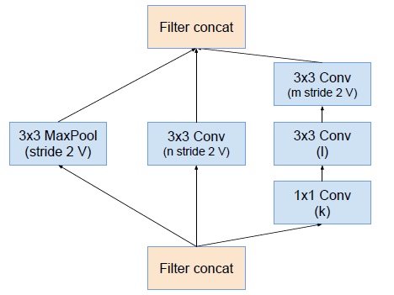
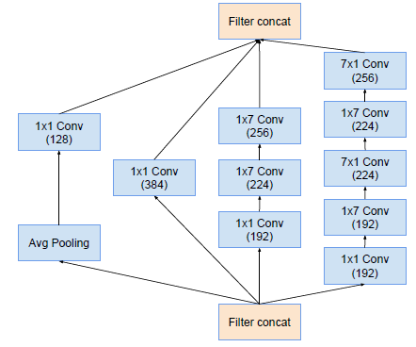


Inception-A
Inception v4
Stem
Reduction-A
Inception-B
Reduction-B
Inception-C

Slide 24


Inception-ResNet

Slide 25


Inception-ResNet
Inception-ResNet v1 ：计算量和Inception v3相当
Inception-ResNet v2 ：计算量和Inception v4相当
Although the residual version converges faster, the final accuracy seems to mainly depend on the model size.

Slide 26
Width-based CNNs

Slide 27


Wide ResNet (WRN)
Notes:
Motivition:
虽然说resnet的模型可通过不断增加深度来获得能力提升（即分类准备性能提高），但愈到后期，靠单纯增加模型层数换来的边际性能提升愈低。
Effect:
1）加宽Residual block意味着会带来训练参数数目平方级数目的增加,容易造成overfitting
2）block里面插入Dropout层有效地避免了overfitting问题

Slide 28



Slide 29




Deep Pyramidal Residual Networks

Slide 30




Slide 31





Xception
Notes:
深度可分离卷积
空间就空间
通道就通道
不要共同映射

Slide 32




ResneXt (Aggregated Residual Transform Network)
1. split-transform-merge (between inception and resnet)
C is the size of the set of transformations
to be aggregated. We refer to C as cardinality

Slide 33

2. Grouped convolutions

Slide 34


Slide 35

Inception family
Input→Stem→A→ReducitonA→B→ReductionB→C→Avg Pooling(+Linear)→feature
Inception-V1（GoogLeNet）、BN-Inception、
Inception-V2、
Inception-V3、
Inception-ResNet-V1、Inception-V4、
Inception-ResNet-V2

Slide 36
Feature-Map (ChannelFMap) Exploitation based CNNs
Some of the feature-maps impart little or no role in object discrimination.

Slide 37


Slide 38


Slide 39


Slide 40


Slide 41


Slide 42


Slide 43

Competitive Inner-Imaging Squeeze and Excitation for Residual Network（CMPESE Network）

Slide 44


Slide 45
Channel Boosted Convolutional Neural Network using Transfer Learning
Qiushi Lin

Slide 46

Channel Boosted deep CNN (CB-CNN)

Slide 47

Details of the working of CB-CNN

Slide 48


Training of AE
Sparsity constraint for AE is defined as
Unsupervised learning loss

Slide 49
Fine-tuning using boosted input
fine-tuning of the pre-trained Inception-V3 is performed
the final layer (fully connected net) of the network is trained from scratch
the whole network is fine-tuned using the boosted input

Slide 50
Advantage of deploying TL
the transferred feature maps from the pre-trained CNN reduce the training cost and help in improving the generalization
augmentation of the auxiliary channels available through TL from the already trained Deep NN (generative model) with original feature maps improves the classifier's representation capacity for complex classification problems.

Slide 51
Attention based CNN
Speaker: Zhu Liu

Slide 52

Outline

Slide 53
Outline
CBAM: Convolutional Block Attention Module (ECCV 2018; 992)
Concurrent Spatial and Channel ‘Squeeze & Excitation’ in Fully Convolutional Networks (MICCAI 2018; 134)
Residual Attention Network for Image Classification (CVPR 2018; 1142)

Slide 54
Attention? Attention!
WHAT to attend?
HOW to get the attention weight map (importance distribution)?
WHERE to put the attention module on the original network?

Slide 55


CBAM
Notes:
Although the Convolutional Block Attention Module (CBAM) was brought into fashion in the ECCV 2018 paper titled "CBAM: Convolutional Block Attention Module", the general concept was introduced in the 2016 paper titled "SCA-CNN: Spatial and Channel-wise Attention in Convolutional Networks for Image Captioning".

Slide 56

CBAM

Slide 57

SE-sc
Notes:
The extension of SE net adding spatial attention and applying to (medical) image segmentation.

Slide 58

Residual Attention Module

Slide 59

Residual Attention Module

Slide 60
Light CNN
Minghui Chen

Slide 61




MobileNet v1
深度可分离卷积（Depthwise seperable convolution）=深度卷积(depthwise convolution)+逐点卷积(pointwise convolution)。
Input channel M Output channel N
Kernel size $D_{K}∗D_{K}$ Output feature size $D_{F}∗D_{F}$
ReLU6就是普通的ReLU但是限制最大输出值为6（对输出值做clip），这是为了在移动端设备float16的低精度的时候，也能有很好的数值分辨率，如果对ReLU的激活范围不加限制，输出范围为0到正无穷，如果激活值非常大，分布在一个很大的范围内，则低精度的float16无法很好地精确描述如此大范围的数值，带来精度损失。
Ref: https://zhuanlan.zhihu.com/p/70703846

Slide 62






MobileNet v2
关键改进点：Linear Bottleneck和Inverted Residual。
MobileNet v1的问题：深度卷积部分的卷积核比较容易训废掉：训完之后发现深度卷积训出来的卷积核有不少是空的，并将这个锅递给了ReLU。
做了个实验，就是对一个n维空间中的一个“东西”做ReLU运算，然后（利用T的逆矩阵$T^{−1}$恢复）对比ReLU之后的结果与Input的结果相差有多大。
现在还有个问题是，深度卷积本身没有改变通道的能力，来的是多少通道输出就是多少通道。如果来的通道很少的话，DW深度卷积只能在低维度上工作，这样效果并不会很好，所以我们要“扩张”通道。既然我们已经知道PW逐点卷积也就是1×1卷积可以用来升维和降维，那就可以在DW深度卷积之前使用PW卷积进行升维（升维倍数为t，t=6），再在一个更高维的空间中进行卷积操作来提取特征：
概括而言，就是对低维度做ReLU运算，很容易造成信息的丢失。而在高维度进行ReLU运算的话，信息的丢失则会很少。
这就解释了为什么深度卷积的卷积核有不少是空。作者解决的方案：将ReLU替换成线性激活函数，但不是所有ReLU都换成线性激活函数，而是将每一个Block的最后一个ReLU换成线性激活函数。
MobileNet v3
多个小细节的改动（trick的堆叠）：架构基于NAS实现的MnasNet，新的激活函数h-swish(x)，引入SE结构。（不展开了）

Slide 63




ShuffleNet v1
关键创新点：Pointwise Group Convolution, Channel Shuffle。
分组卷积和深度可分离卷积
我们可以看出组内Pointwise卷积可以非常有效的缓解性能瓶颈问题。然而这个策略的一个非常严重的问题是卷积直接的信息沟通不畅，网络趋近于一个由多个结构类似的网络构成的模型集成，精度大打折扣。
普通卷积
分组卷积：分组卷积最早是出现在AlexNet，当时这么做是为了解决显存不够的问题，单卡无法容纳模型。
当g=1时，分组卷积为普通卷积；当g=C时，分组卷积为深度卷积（depthwise convolution）。
可以看到当堆积GConv层后一个问题是不同组之间的特征图是不通信的，这就好像分了三个互不相干的路，大家各走各的，这目测会降低网络的特征提取能力。这样你也可以理解为什么Xception，MobileNet等网络采用密集的x卷积，因为要保证group convolution之后不同组的特征图之间的信息交流。
而逐点分组卷积（Pointwise Group Convolution）则是在其后接的1*1卷积的深度（通道）也做同样分组操作，其实就是对Depthwise separable convolution加了个分组操作，使得密集的1*1卷积操作变得相对稀疏，降低计算量。

Slide 64




ShuffleNet v2
关键改进点：Channel Split。
四个高效网络设计指南
通道分离（Channel Split）：
1.在每个单元的开始，通过Channel split将c特征通道的输入被分为两支，分别带有 c−c' 和c'个通道。按照准则G3，一个分支的结构仍然保持不变。另一个分支由三个卷积组成， 为满足G1，令输入和输出通道相同。与 ShuffleNet V1 不同的是，两个 1×1 卷积不再是组卷积(GConv)，因为Channel Split分割操作已经产生了两个组。
2.卷积之后，把两个分支拼接(Concat)起来，从而通道数量保持不变 (G1)，而且也没有Add操作（element-wise操作）（G4）。然后进行与ShuffleNetV1相同的Channel Shuﬄe操作来保证两个分支间能进行信息交流。
3.depthwise convolution保留
G1: 输入输出具有相同channel的时候，内存消耗是最小的。
G2: 过多的分组卷积操作会增大MAC，从而使模型速度变慢。
根据G1准则中的MAC计算公式，可以看出在B不变时，g越大，MAC也越大。
G3: 模型中的分支数量越少，模型速度越快。
作者认为，模型中的网络结构太复杂（分支和基本单元过多）会降低网络的并行程度，模型速度越慢。
G4: Element-wise操作不能被忽略。
Element-wise包括Add/ReLU/short-cut/depthwise convolution等操作。元素操作类型操作虽然FLOPs非常低，但是带来的时间消耗还是非常明显的，尤其是在GPU上。元素操作操作虽然基本上不增加FLOPs，但是所带来的时间消耗占比却不可忽视。也即Small FLOPs heavy MAC
Ref: https://zhuanlan.zhihu.com/p/67009992

